Slide 1


Assembly Validation

Slide 2


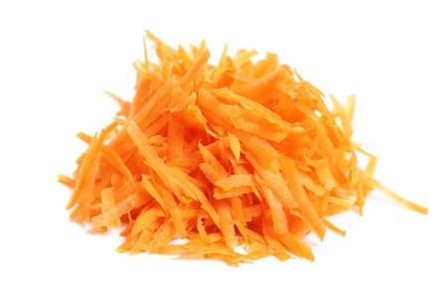


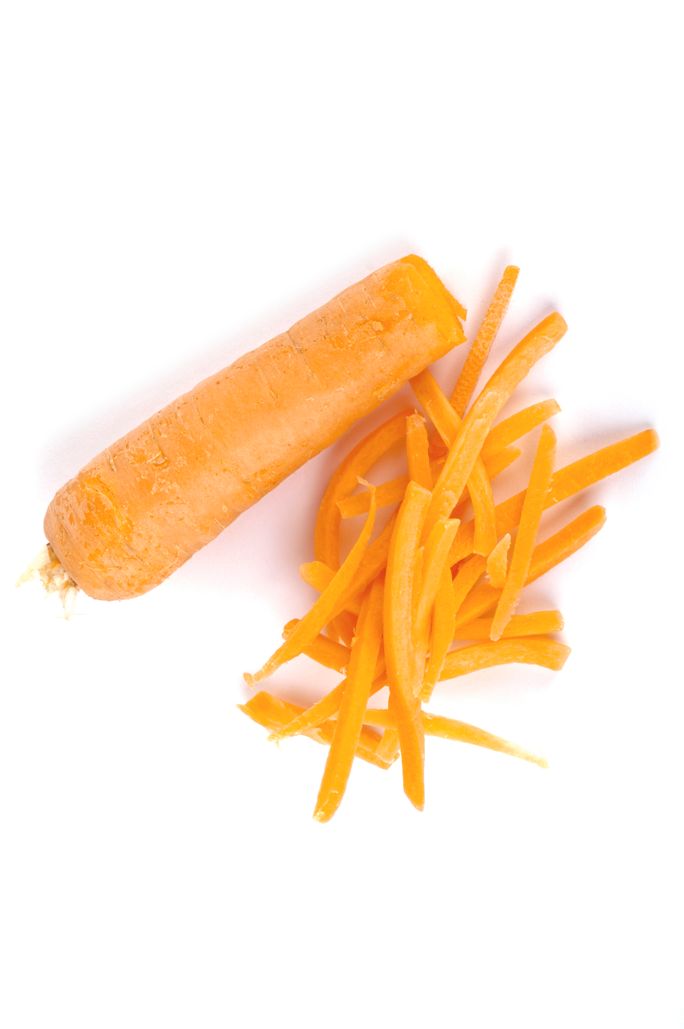


Assembly
What is an assembly?

Slide 3
Basic assembly statistics
Percentage of assembly in scaffolded contigs 4.2%
Percentage of assembly in unscaffolded contigs 95.8%
Average number of contigs per scaffold 1.0
Average length of break (>25 Ns) between contigs in scaffold 191
Number of contigs 9082
Number of contigs in scaffolds 72
Number of contigs not in scaffolds 9010
Total size of contigs 22857451
Longest contig 621740
Shortest contig 56
Number of contigs > 1K nt 2527 27.8%
Number of contigs > 10K nt 329 3.6%
Number of contigs > 100K nt 34 0.4%
Number of contigs > 1M nt 0 0.0%
Number of contigs > 10M nt 0 0.0%
Mean contig size 2517
Median contig size 571
N50 contig length 25795
L50 contig count 158
NG50 contig length 188047
LG50 contig count 8
N50 contig - NG50 contig length difference 162252
contig %A 28.57
contig %C 21.46
contig %G 21.39
contig %T 28.58
contig %N 0.01
contig %non-ACGTN 0.00
Number of contig non-ACGTN nt 0

Slide 4
Basic assembly statistics
Longest contig 621740
Shortest contig 56
Number of contigs > 1K nt 2527 27.8%
Number of contigs > 10K nt 329 3.6%
Number of contigs > 100K nt 34 0.4%
Number of contigs > 1M nt 0 0.0%
Number of contigs > 10M nt 0 0.0%
Mean contig size 2517
Median contig size 571
N50 contig length 25795
L50 contig count 158
NG50 contig length 188047
LG50 contig count 8
Poor Assembly.
Many contigs
< 1kb

Slide 5
Basic assembly statistics
N50 is a common statistical measure of sequence length.
The size of the smallest contig in the set of largest contigs that make up 50% of the assembly size.
50
40
20
20
10
50 + 40 + 20 + 20 + 10 = 140
N50 = 40

Slide 6
Basic assembly statistics
N50 has some disadvantages though
N50 is not a measure of assembly correctness
It only measures sequence contiguity
N50 is not meaningful for different assembly sizes.
It’s not comparable across species, and technically even the same genome.
N50 does not improve for near complete assemblies.
Once you have good scaffolds, only small contigs remain.
N50 is biased if short sequences are excluded.
Often shorter contigs are filtered out from the assembly.

Slide 7
Basic assembly statistics
A better statistic is NG50
The size of the smallest contig in the set of largest contigs that make up 50% of the (estimated) genome size (not assembly).
It is still only a measure of sequence contiguity, but comparable for the same genome.
There is still a limit on when it will not improve further.
Smaller contigs can be filtered out without affecting the value.

Slide 8
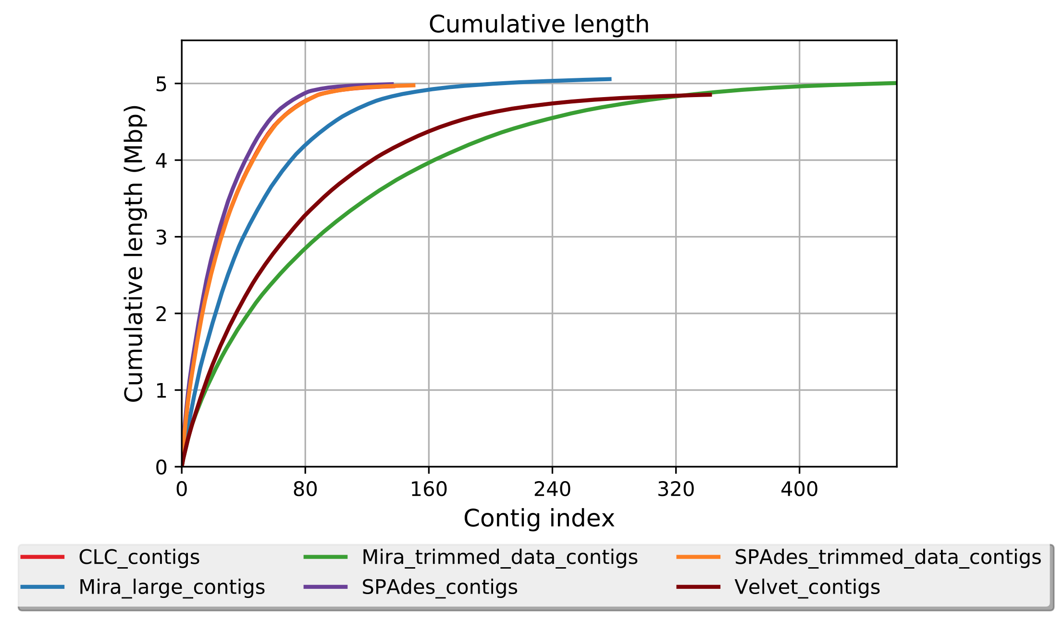
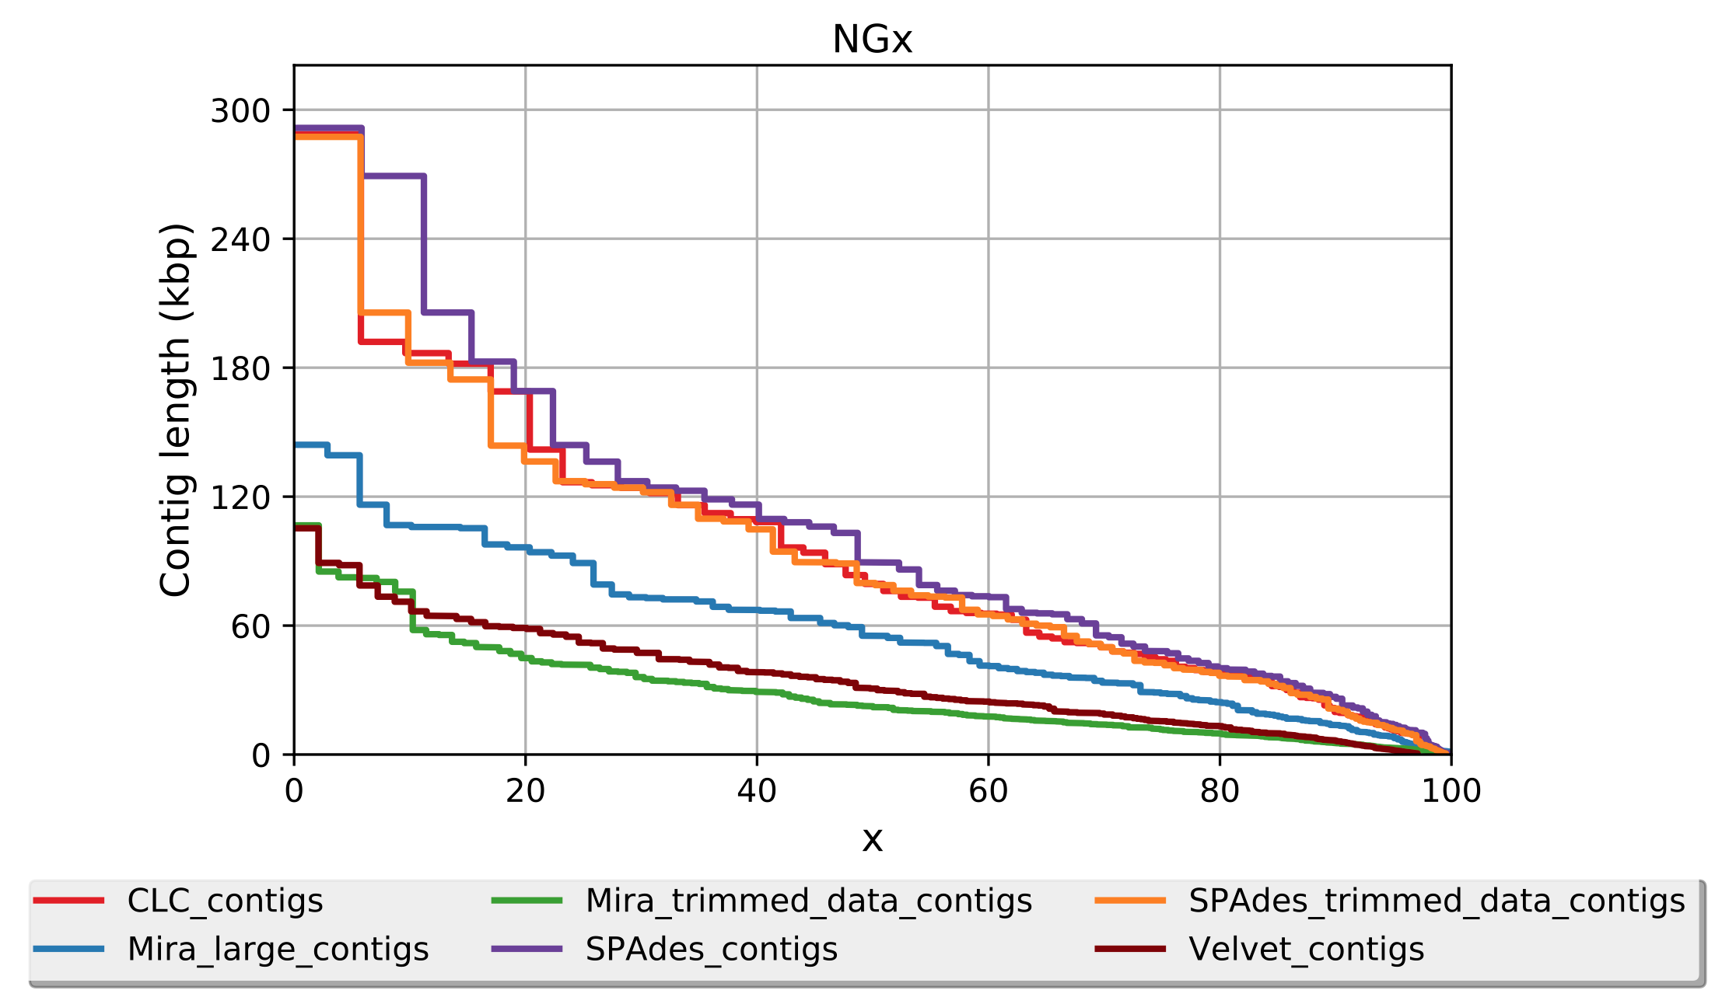
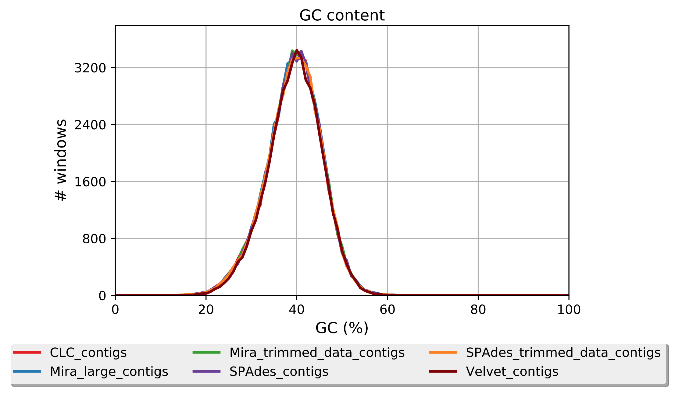
Basic assembly statistics
Tool: Quast
Produces comparisons of assemblies
Statistics include number of contigs, N50, NG50, GC content

Slide 9
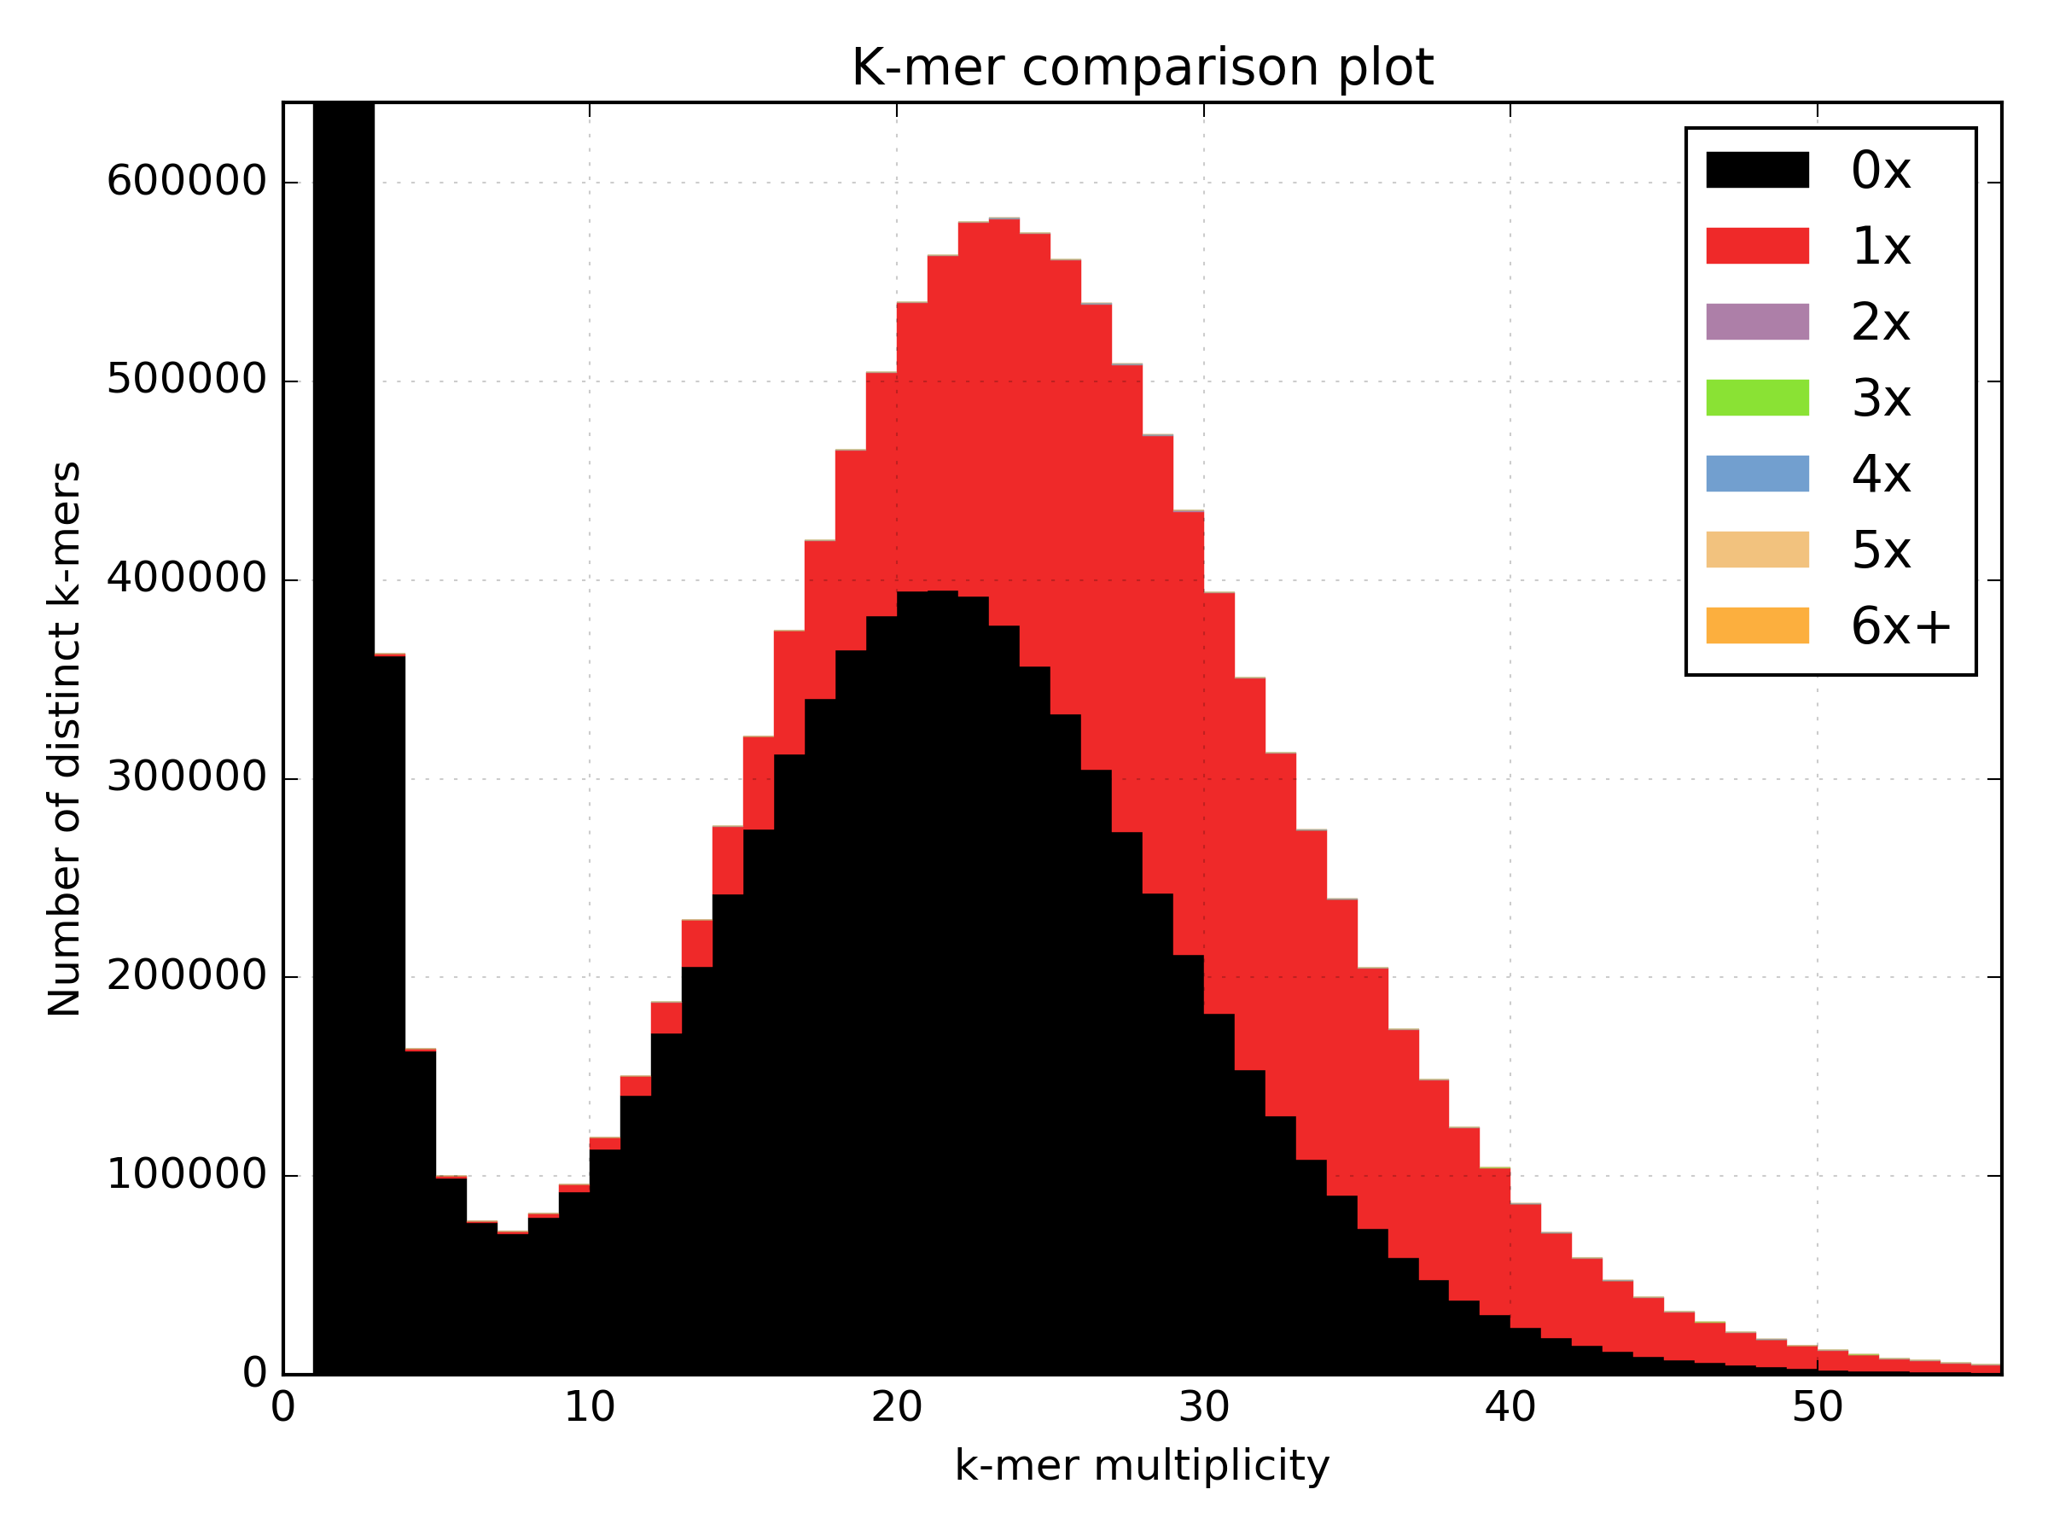
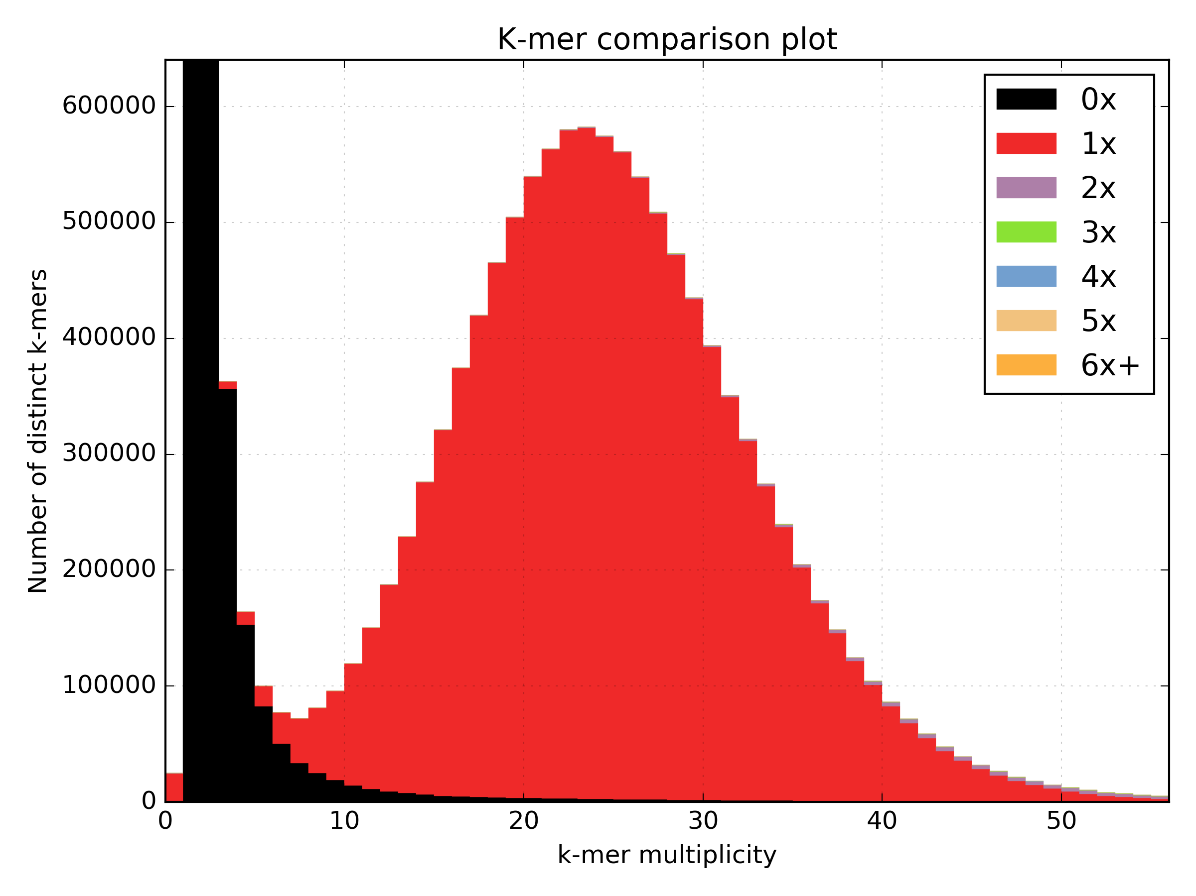
Assembly completeness
K-mer Analysis Toolkit
K-mer comparison plots indicate how well the genome is assembled.
Poor - Many high frequency are k-mers missing from the assembly
Good - Most high frequency are found in the assembly

Slide 10
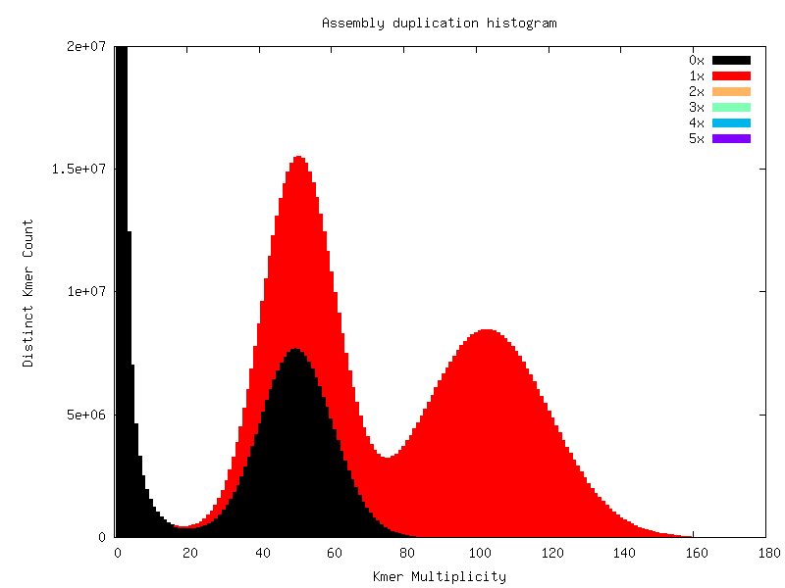
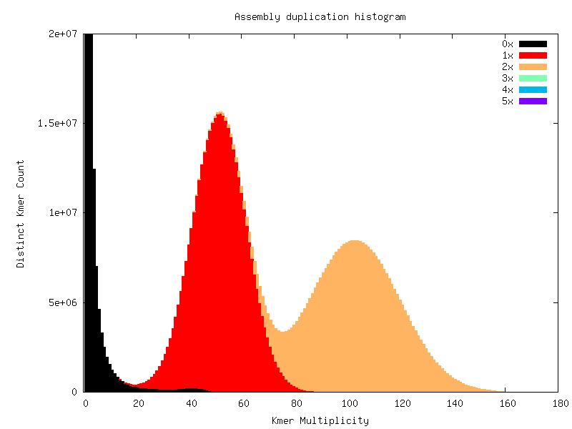
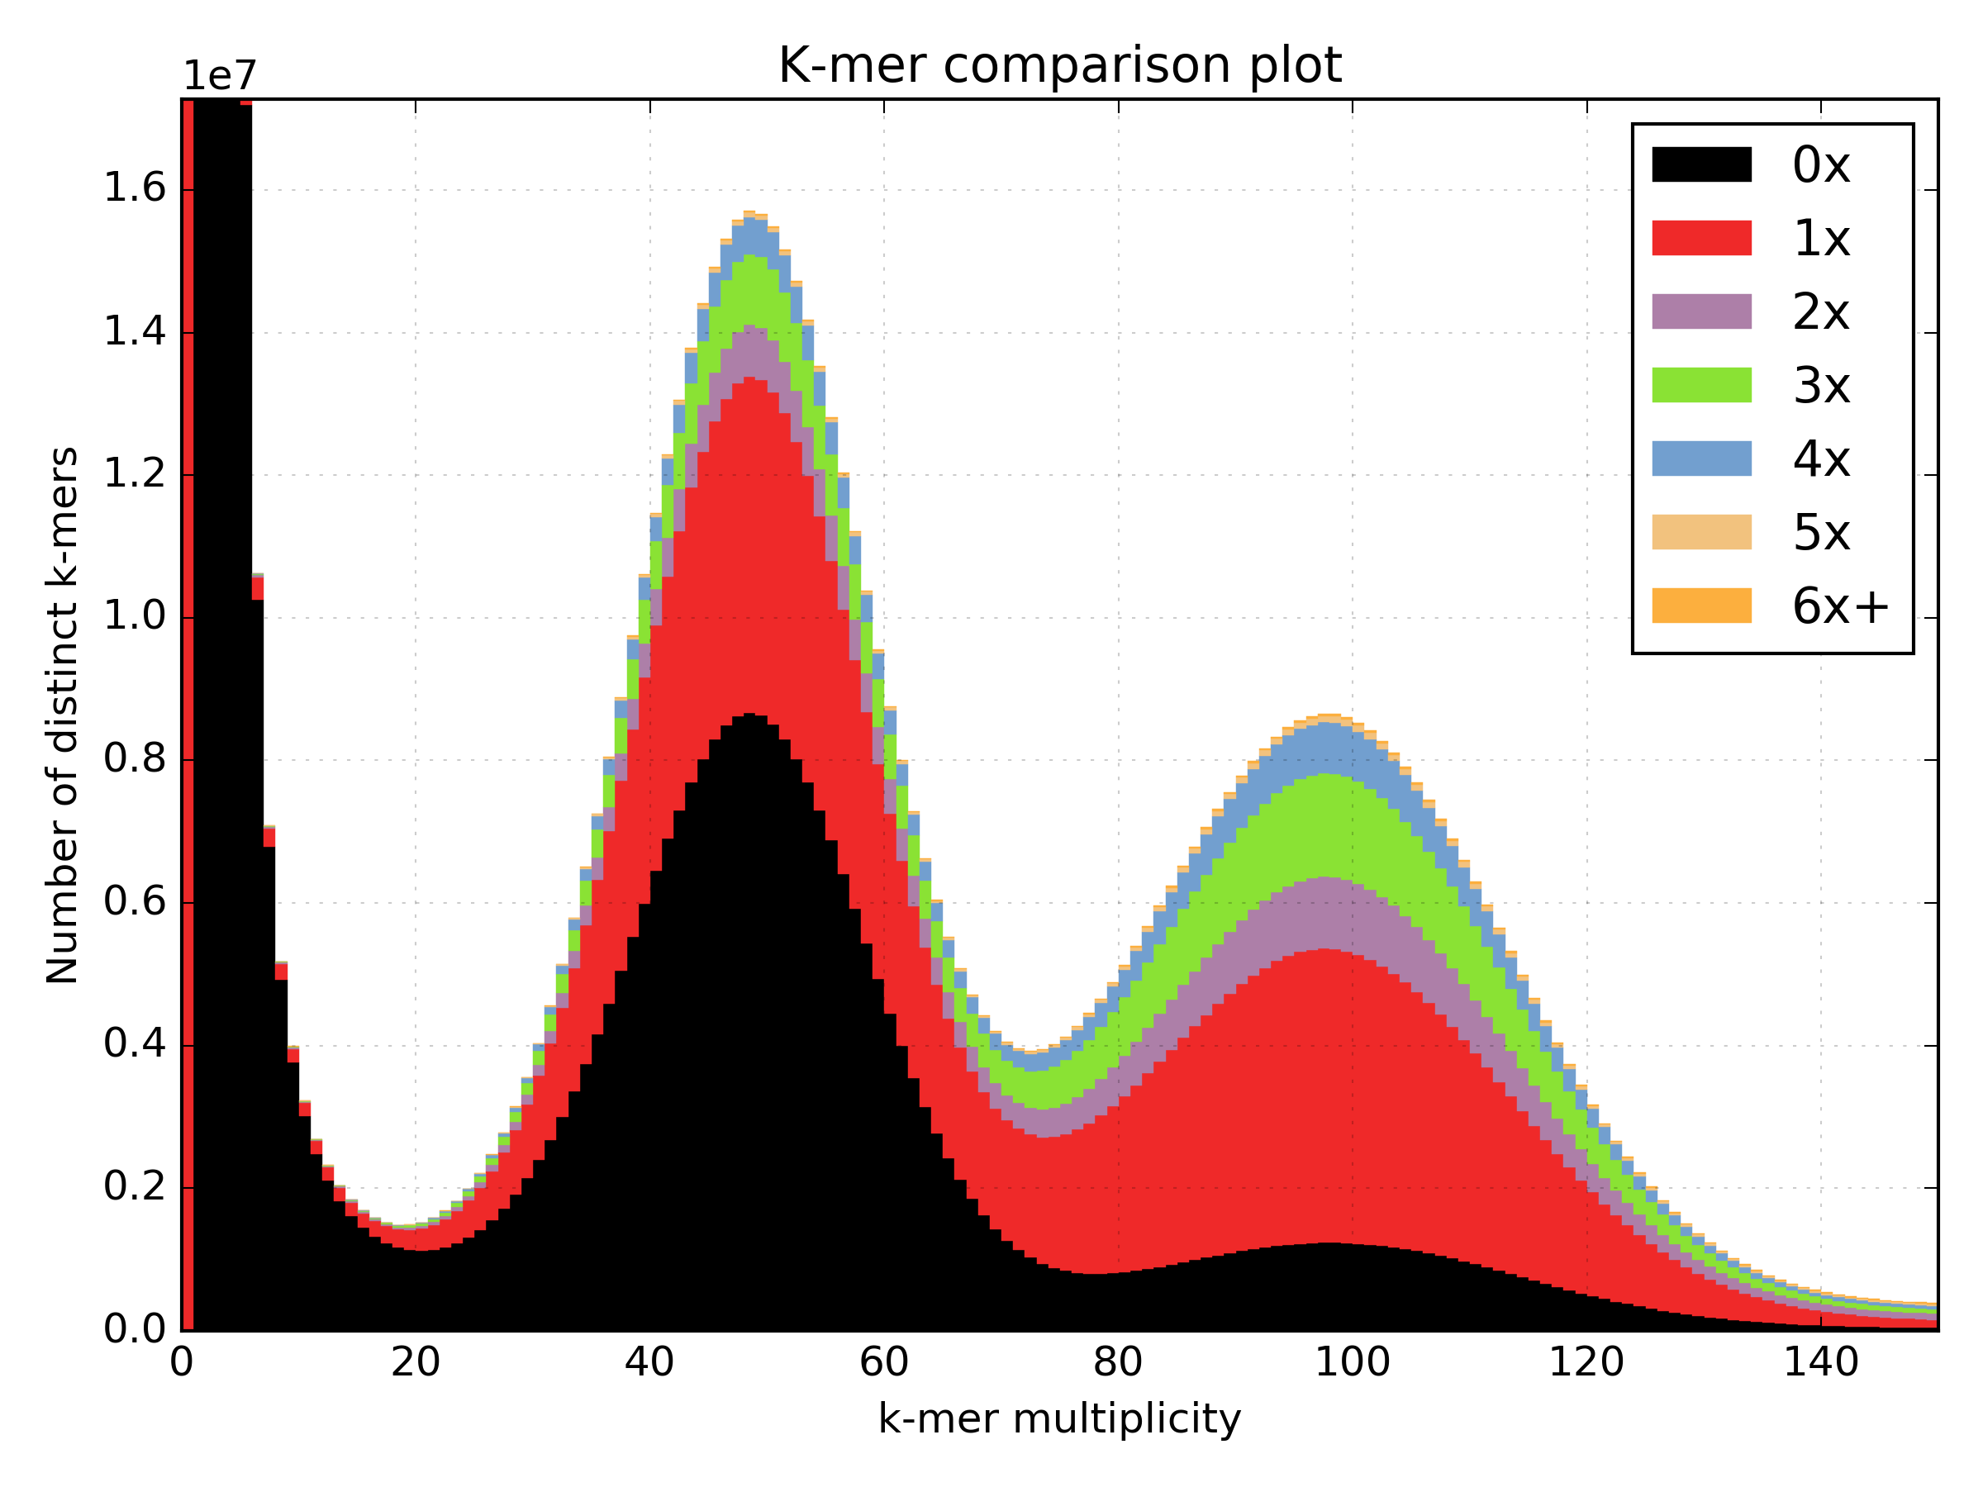
Assembly completeness
K-mer Analysis Toolkit
Good
Bad

Slide 11
Assembly completeness
Samtools flagstat <bamfile>
27190072 + 0 in total (QC-passed reads + QC-failed reads)
0 + 0 secondary
584370 + 0 supplementary
0 + 0 duplicates
25987447 + 0 mapped (95.58% : N/A)
26605702 + 0 paired in sequencing
13302851 + 0 read1
13302851 + 0 read2
23321920 + 0 properly paired (87.66% : N/A)
25250050 + 0 with itself and mate mapped
153027 + 0 singletons (0.58% : N/A)
1196126 + 0 with mate mapped to a different chr
439746 + 0 with mate mapped to a different chr (mapQ>=5)

Slide 12
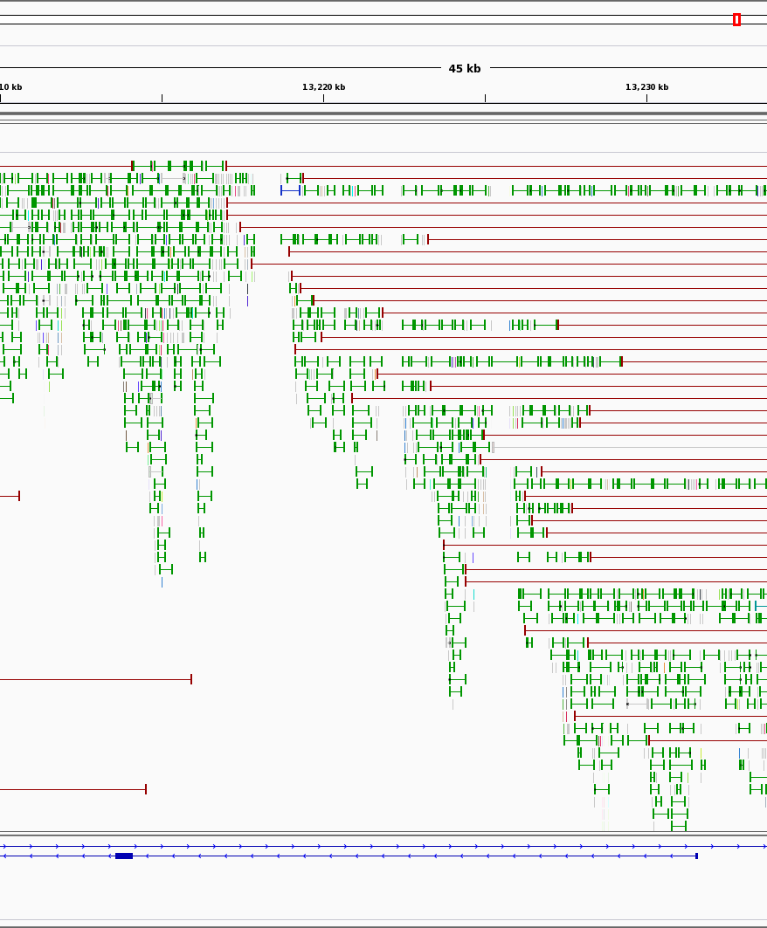
Read alignment properties
Aligning reads back to the draft assembly tells us about data congruency.
Which areas of the assembly have no / reduced coverage?
Do paired reads align to different contigs?
Do paired reads align to close or too far apart?
Do paired reads align in the wrong orientation?

Slide 13
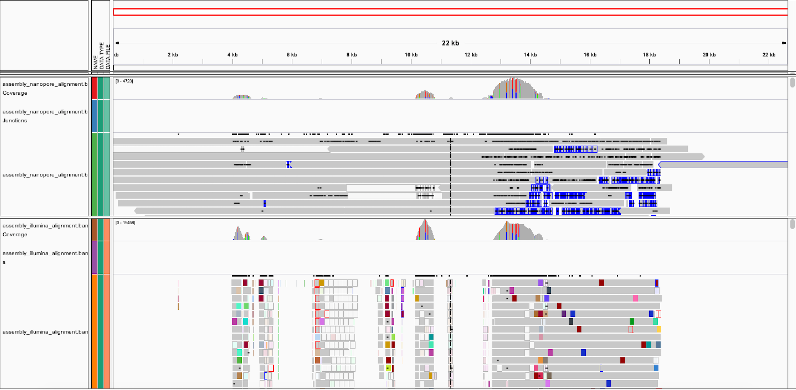
Read alignment properties
IGV - Genome Browser
Coverage tracks show poor coverage
No read support

Slide 14
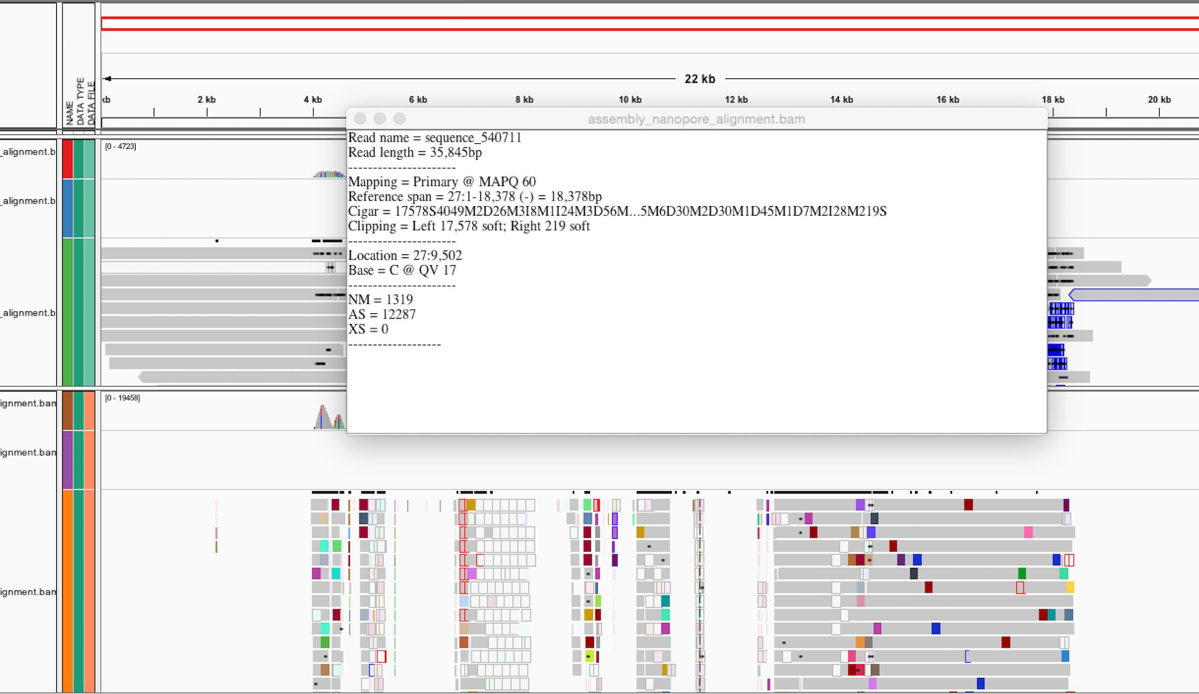
Read alignment properties
22kb contig
35kb read
Softpadded bases in alignment

Slide 15
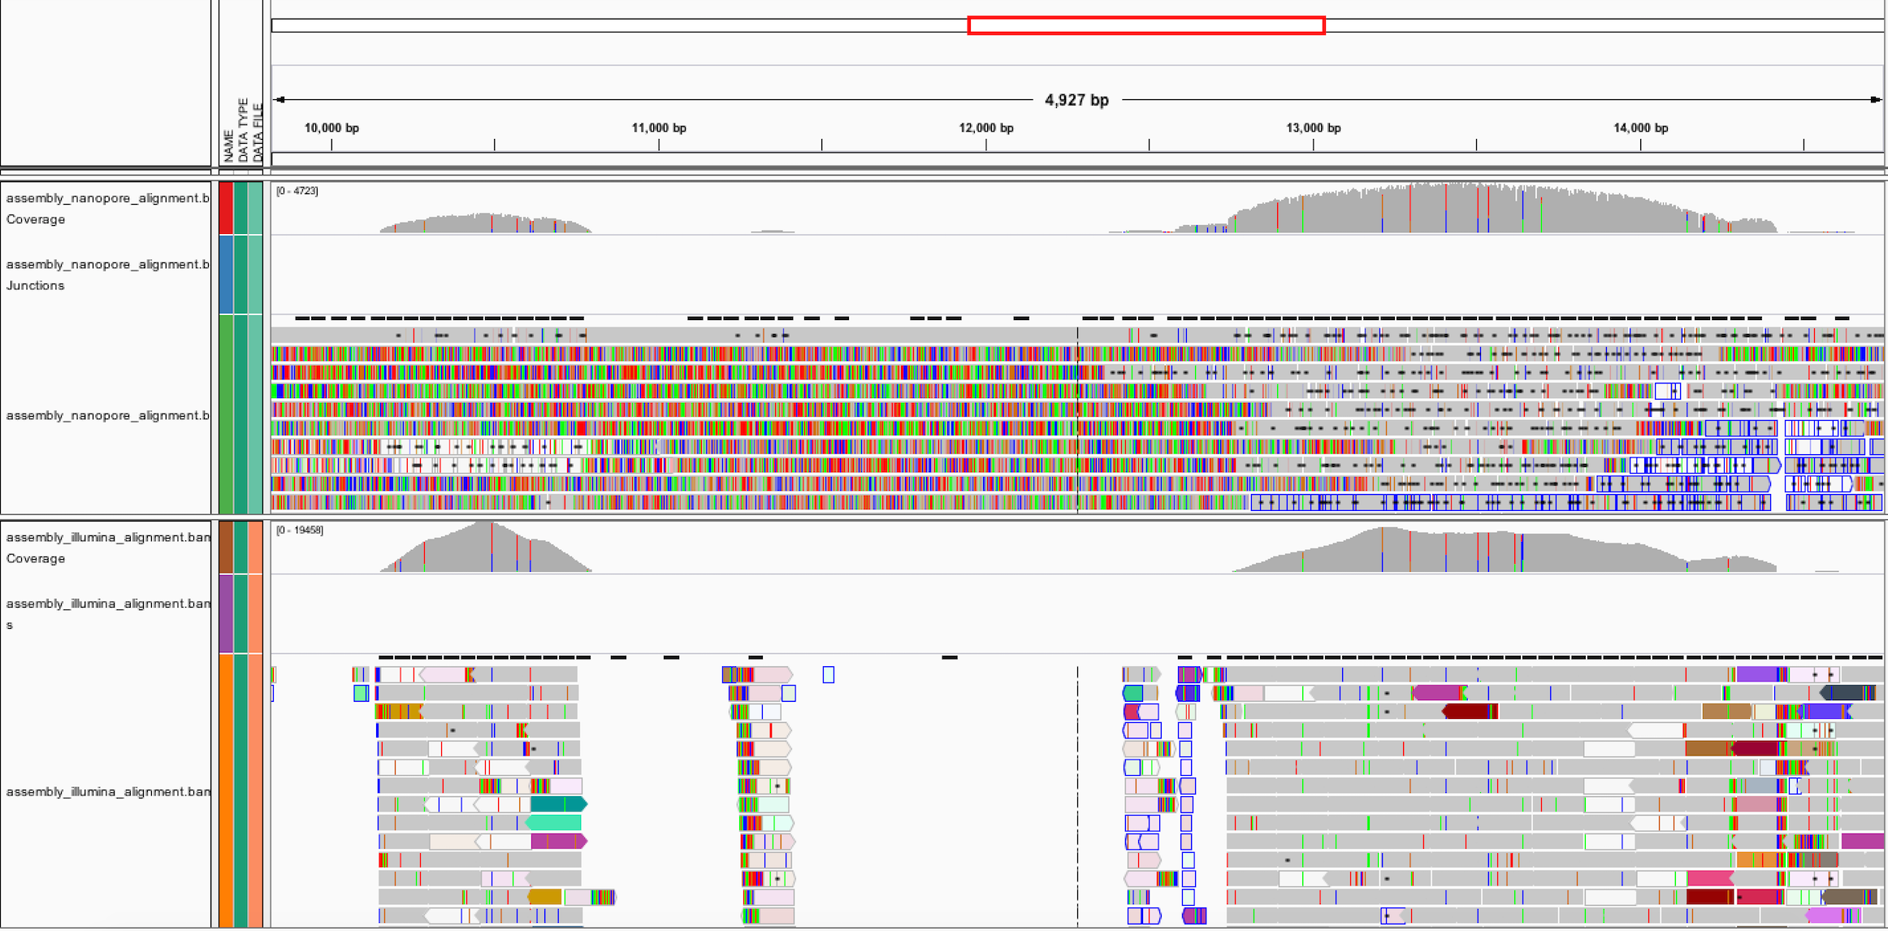
Read alignment properties
Bases in disagreement
Read pairs are inconsistent

Slide 16
Read alignment properties
Downstream processing assumes correct assembly
Repeats and heterozygosity complicate assembly, however misassemblies are a primary reason for failing to improve assemblies further.
This misassembly prevents the contigs from being scaffolded correctly

Slide 17
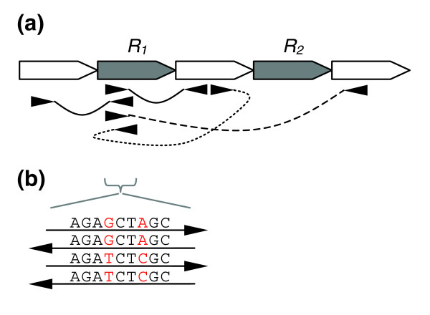
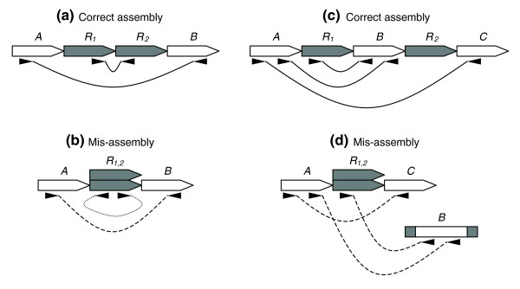
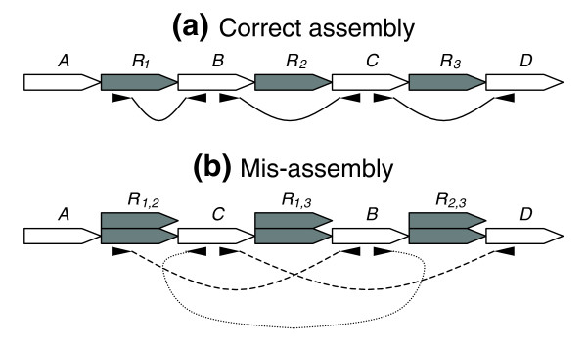
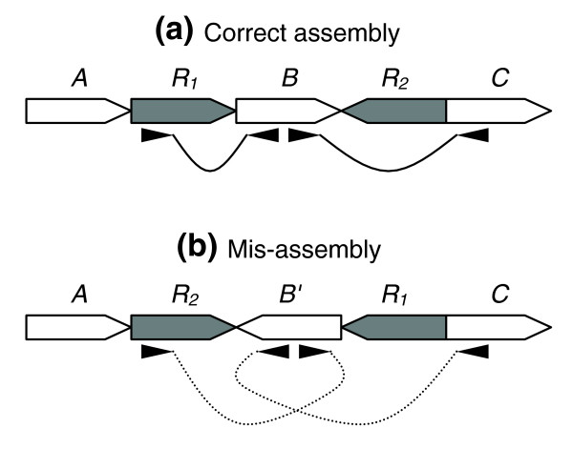
Read alignment properties

Slide 18
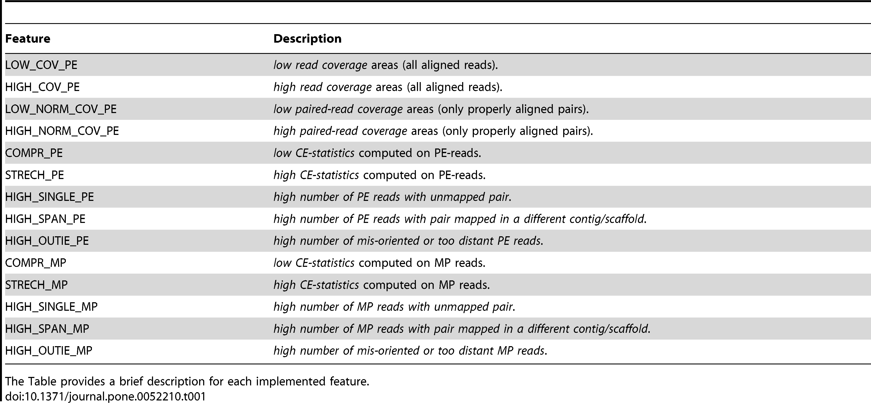
Read alignment properties
FRCBam

Slide 19
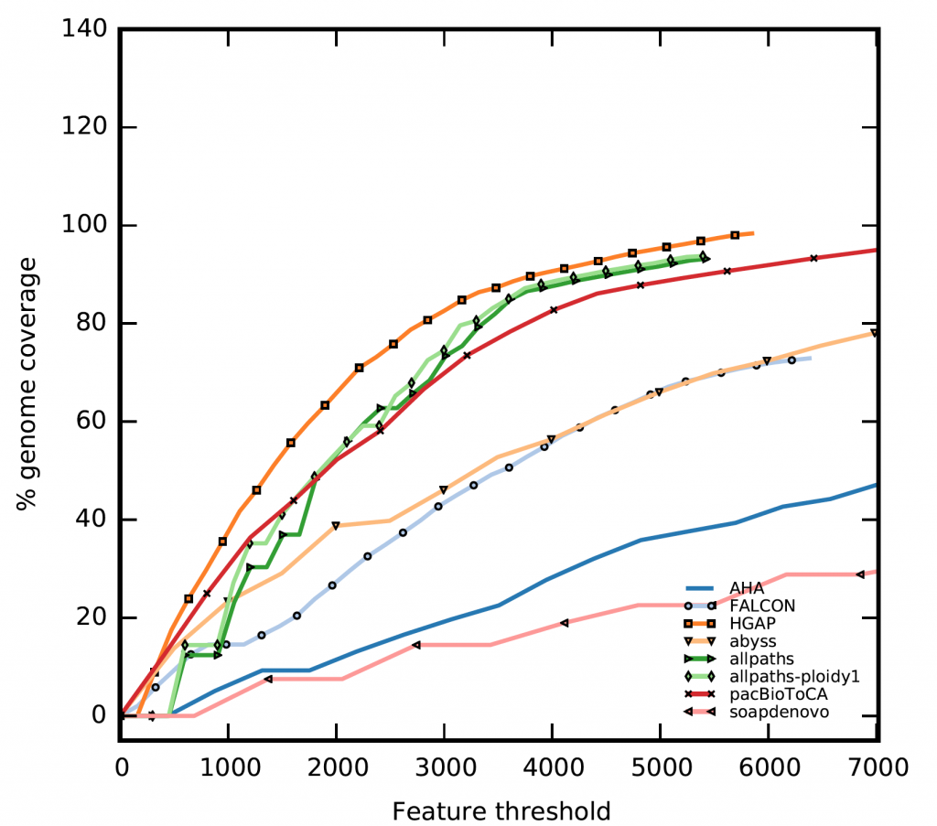
Read alignment properties
FRCBam
Feature Response Curve (only comparable if estimated genome size is used).
The best assembly has the least features.

Slide 20
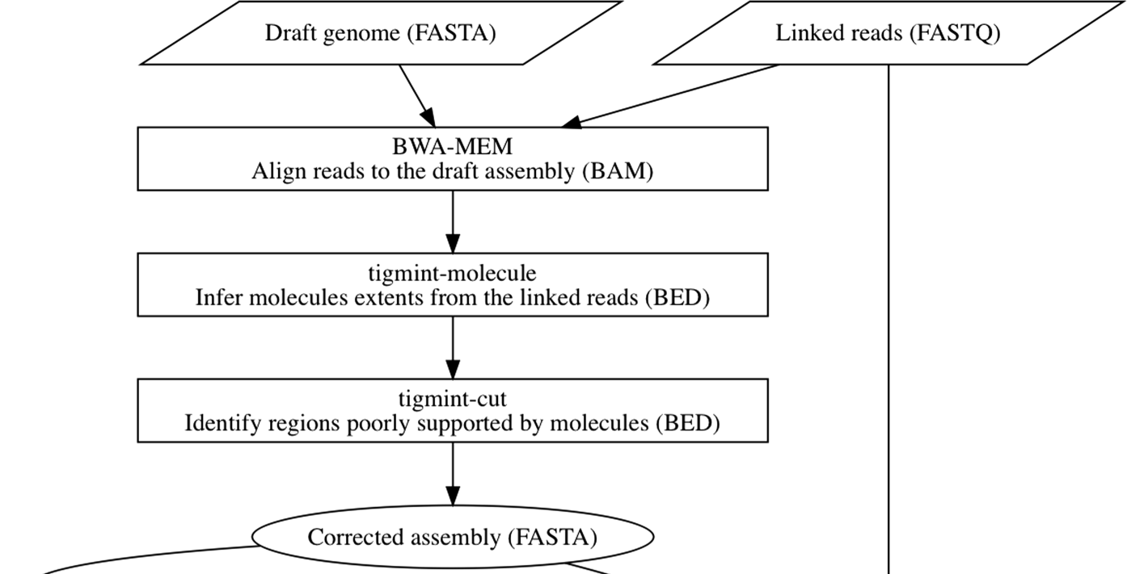
Read alignment properties
TigMint

Slide 21
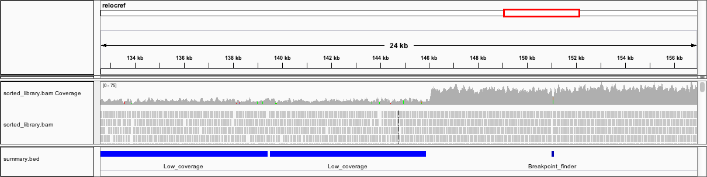
Correcting an assembly
Manually breaking a contig
Programs
Reapr
[GAP5]
[QuickMerge]
[BIGMAC]

Slide 22
Summary
Assembly statistics are a good starting point
N50, NG50 is not a measure of accuracy or quality
K-mer comparisons of reads vs assembly inform completeness, and quality
Read alignment properties inform completeness, accuracy, and quality.
Check for misassemblies.

